Slide 1
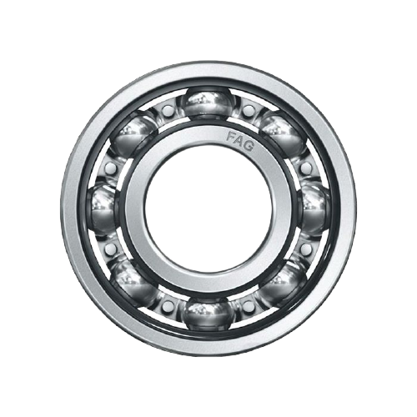

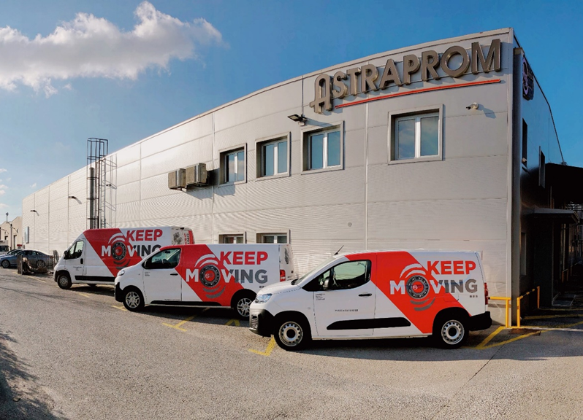
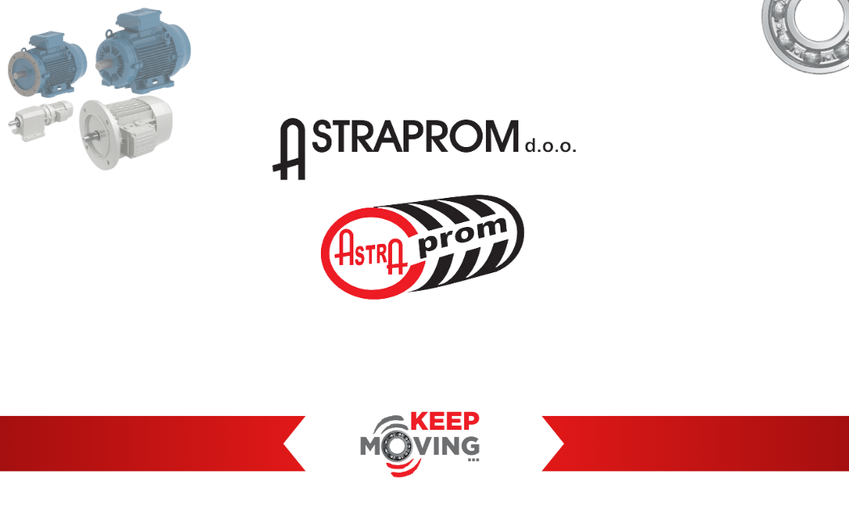

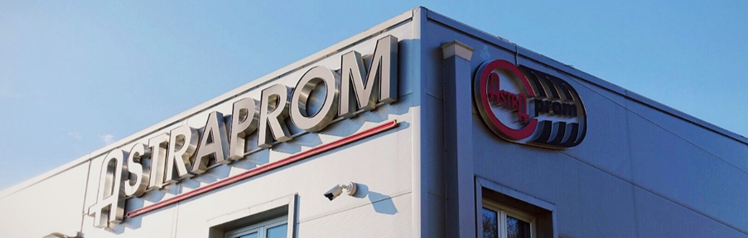


Slide 2

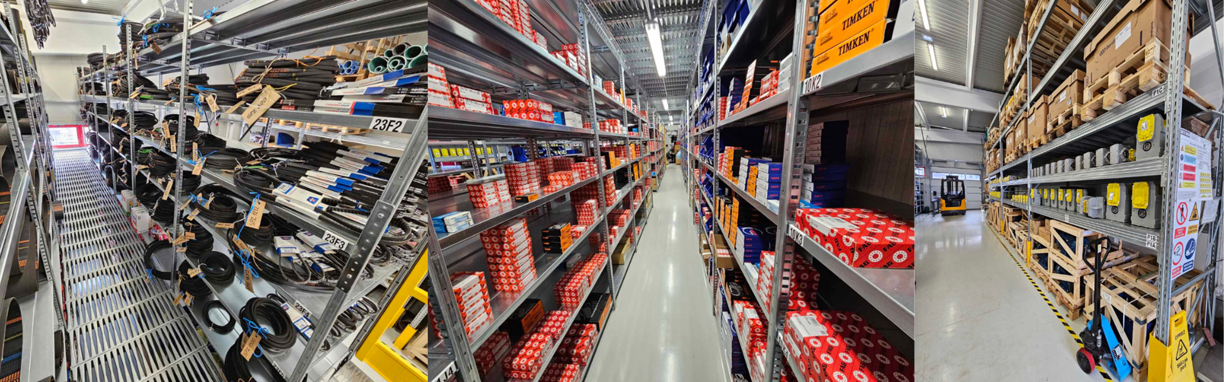

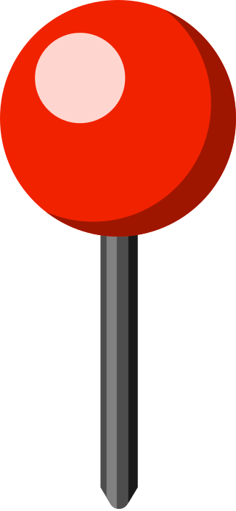


ABOUT US
RELIABILITY THAT LASTS
ASTRAPROM Ltd. is a privately owned company established in 1994, specializing in the distribution of spare parts for industry, crafts, and maintenance.
We are focused on quality, speed, and an individual approach to every client.
Our product range includes:
bearings, electric motors, gearboxes, drive belts, chains, seals, adhesives, lubricants, rubber technical goods, and engineering plastics.
Every product, every delivery, and every partnership is based on the same principle: maximum reliability without compromise.
Sarajevo
01.08.2025.
Samobor
01.03.2022.
Novska
02.01.2025.
Rijeka

Slide 3


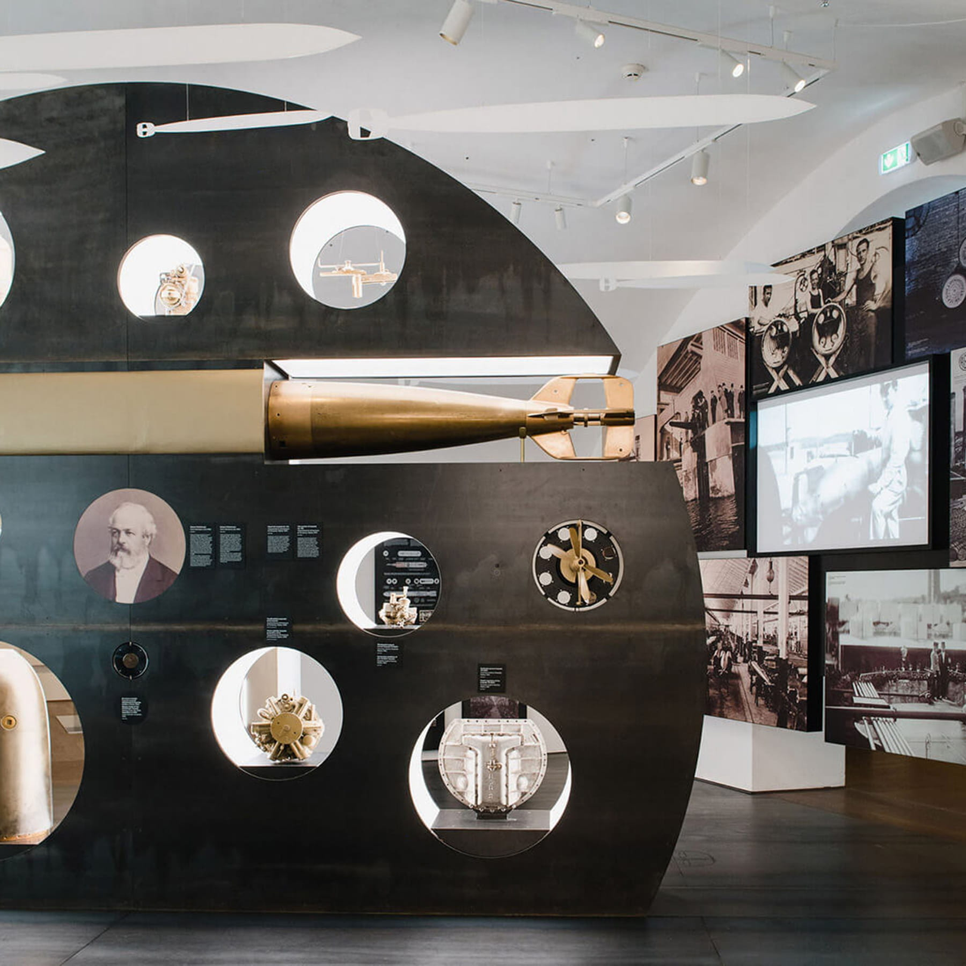
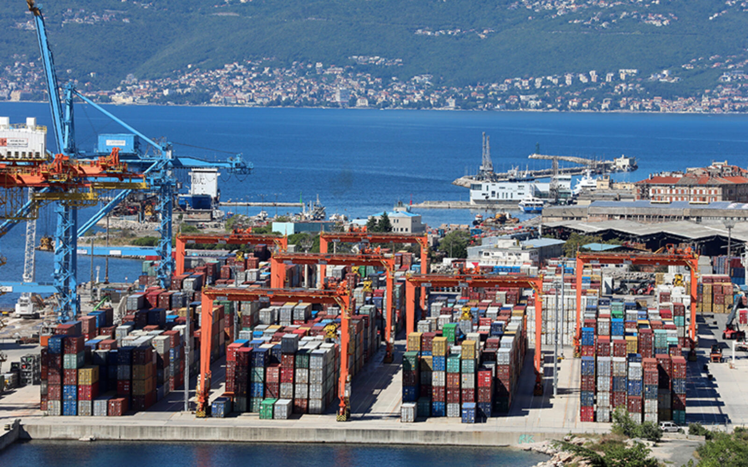
RIJEKA, HRVATSKA
Rijeka is the largest port city in Croatia and one of the most important transport and logistics hubs on the Adriatic coast.
⚓ Port city – a key connection between Central Europe and the sea
🚢 Container terminals – essential for international trade and logistics
🔥 LNG terminal (Krk) – of strategic energy importance for the region
⚽ Football – HNK Rijeka is one of the leading clubs in Croatia
🏛️ Sugar Refinery Palace (Sugar Museum) – part of the Rijeka City Museum, a symbol of industrial heritage
🌴 Opatija (nearby) – a well-known tourist destination in the Kvarner region

Slide 4

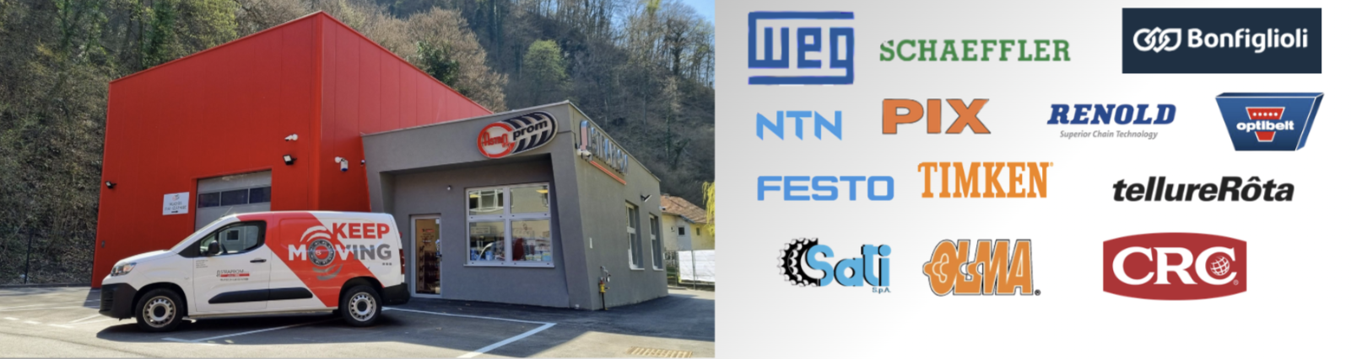
OUR SUPPLIERS
Through partnerships with leading global manufacturers, we ensure top-quality products, reliability, and long-term security for our clients.
Global manufacturers
Proven quality
Direct cooperation
Fast availability

Slide 5
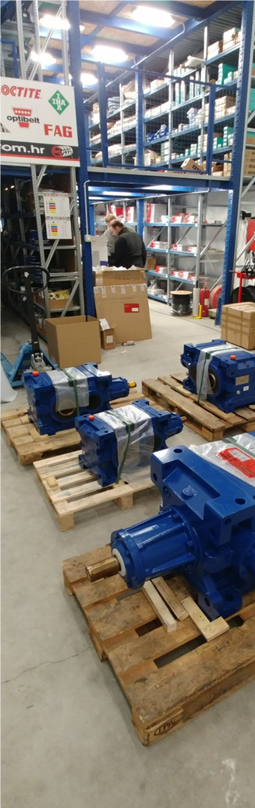
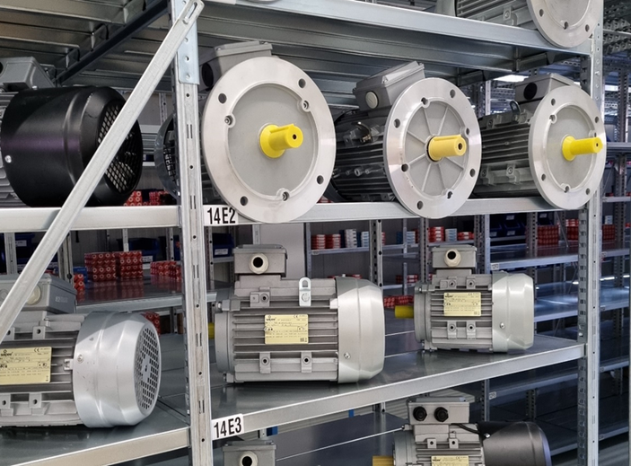


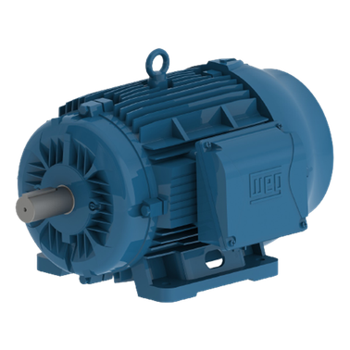

ELECTRIC MOTORS AND GEARBOXES
Industry • Automation • Production • Maintenance
✓ High-efficiency electric motors (IE2, IE3, IE4)
✓ Industrial gearboxes for all types of applications
✓ Complete drive solutions
Reliable solutions for industrial drives through cooperation with leading global manufacturers.

Slide 6
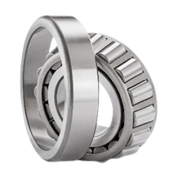
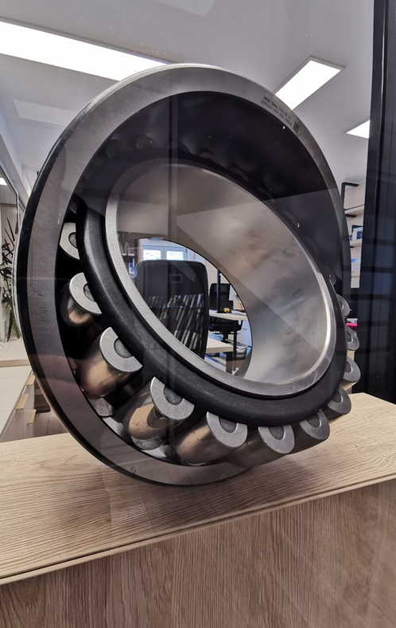




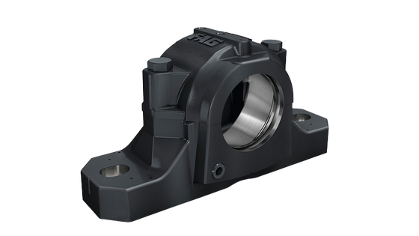

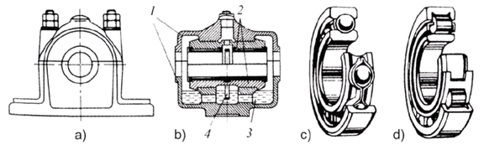
BEARINGS AND BEARING ACCESSORIES
Our offering covers a wide range of solutions – from standard to specialized bearings, as well as a complete range of accessories for installation, maintenance, and protection.
Regardless of the industry or application, we provide reliable solutions that ensure continuous and safe system operation.
✓ Ball and roller bearings
✓ Tapered, cylindrical, and spherical bearings
✓ Self-aligning and axial (thrust) bearings
✓ Bearing housings and mounted units
✓ Accessories: seals, nuts, rings, locking elements, etc.
PRODUCT RANGE

Slide 7

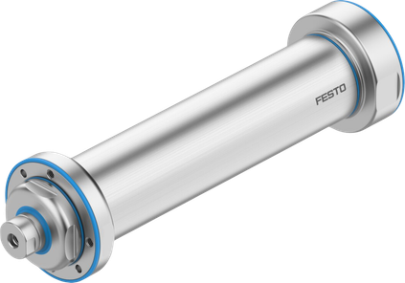
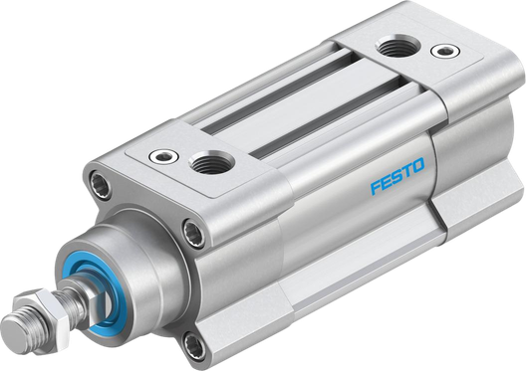
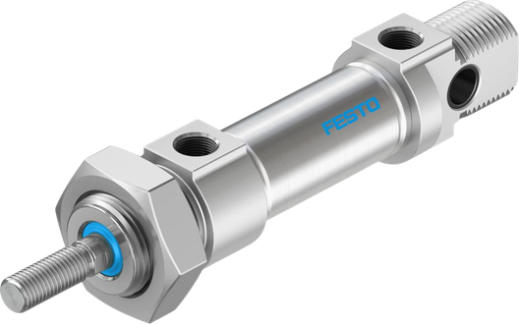
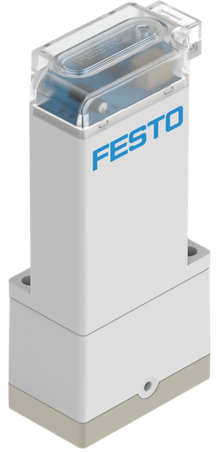
COMPONENTS AND SOLUTIONS
Pneumatic cylinders
Valves and valve terminals
Fittings and tubing
Sensors and actuators
INDUSTRIAL SOLUTIONS
Reliable solutions for modern automation.
FESTO PNEUMATICS AND AUTOMATION
Premium quality and precision
Solutions for industrial automation
Energy-efficient systems
Long service life and reliable operation

Slide 8
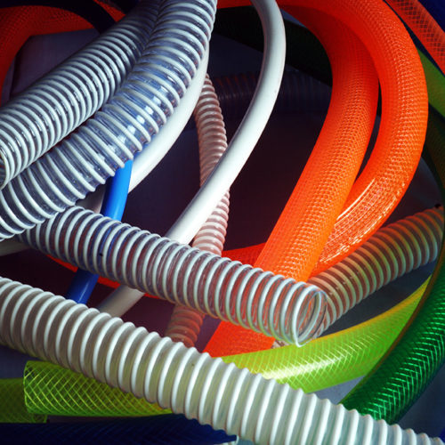
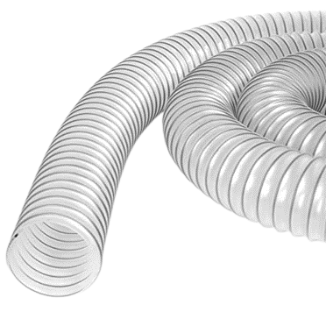
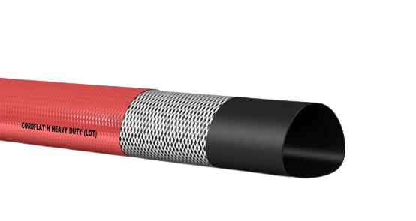
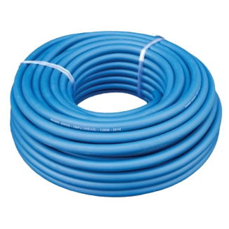
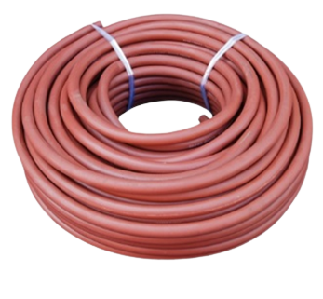
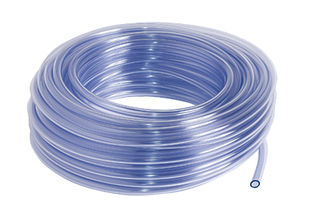
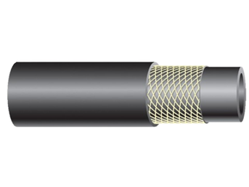
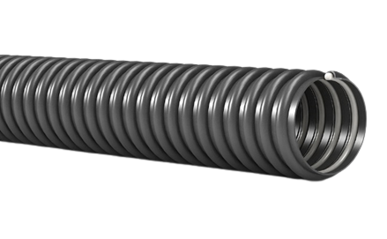
HOSES
A complete range of rubber and PVC hoses for the transport of various media: water, air, oil, gases, chemicals, and food products.
✓ Rubber and PVC hoses
✓ Industrial and food-grade applications
✓ Resistance to pressure, temperature, and chemicals
✓ Various diameters and specifications

Slide 9
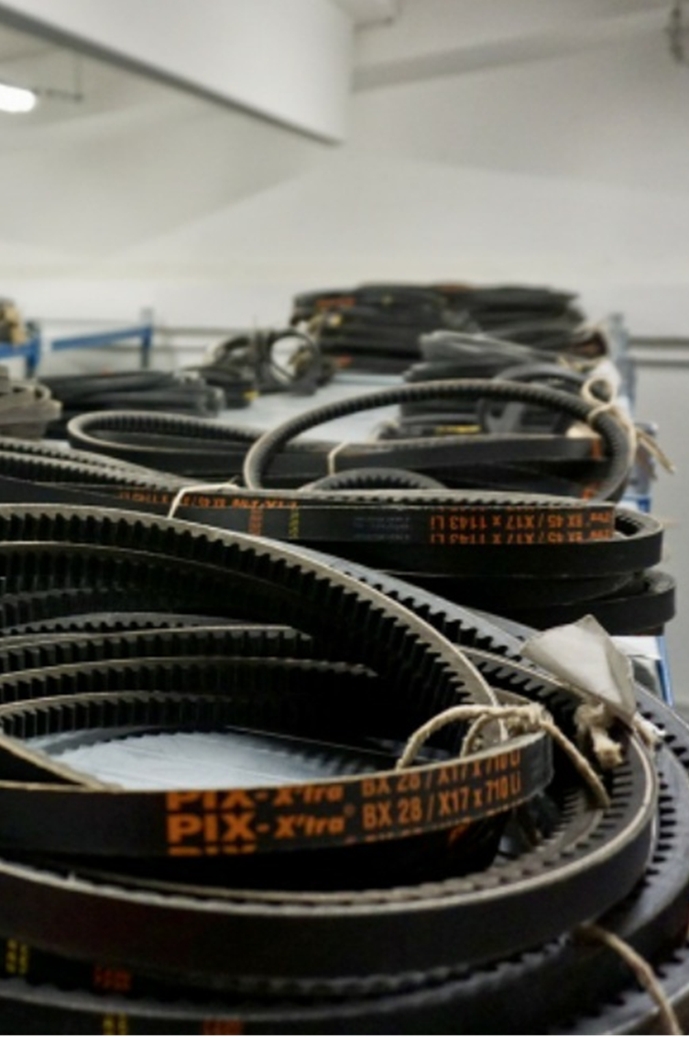



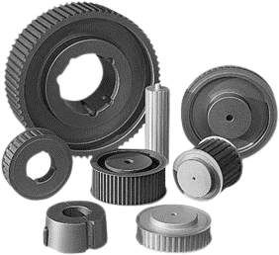
BELTS AND BELT DRIVES
High-quality belts designed for reliable power transmission, high efficiency, and long service life, with resistance to wear, temperature, and chemical influences.
PRODUCT RANGE
✓ V-belts
✓ Timing belts
✓ Belt drives and accessories
✓ High power transmission
✓ Reduced slippage
✓ Resistance to temperature and chemicals
✓ Long service life

Slide 10
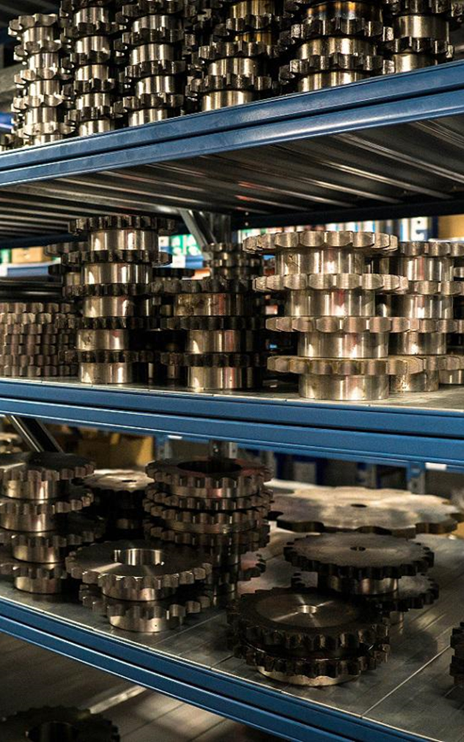
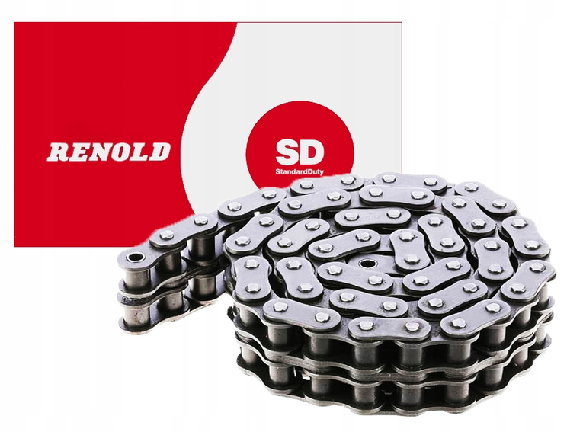

ROLLER CHAINS AND SPROCKETS
OUR RANGE INCLUDES:
✓ Roller chains
✓ Conveyor chains
✓ Lifting chains
✓ Sprockets
Industry • Automation • Production • Maintenance
✓ Single-strand, double-strand, and triple-strand chains
✓ High wear resistance
✓ Long service life
✓ Industrial applications

Slide 11
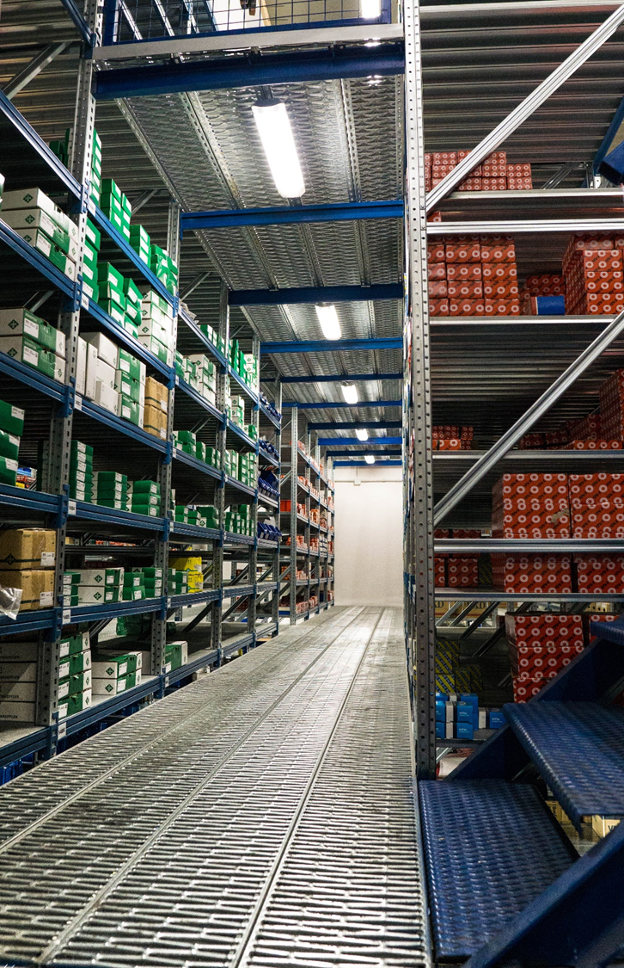



COUPLINGS AND CONNECTING ELEMENTS
Couplings enable the transmission of torque between shafts, while compensating for misalignment and reducing vibrations, ensuring stable and reliable system operation.
KEY ADVANTAGES
✓ Power transmission without losses
✓ Reduced vibrations and loads
✓ Compensation of misalignment
✓ Long service life
PRODUCT RANGE
✓ Flexible couplings
✓ Gear couplings
✓ Disc couplings
✓ Connecting elements

Slide 12
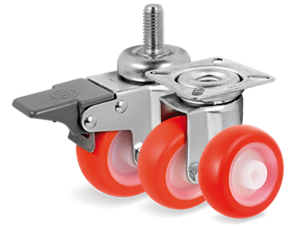
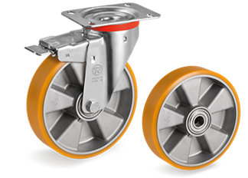
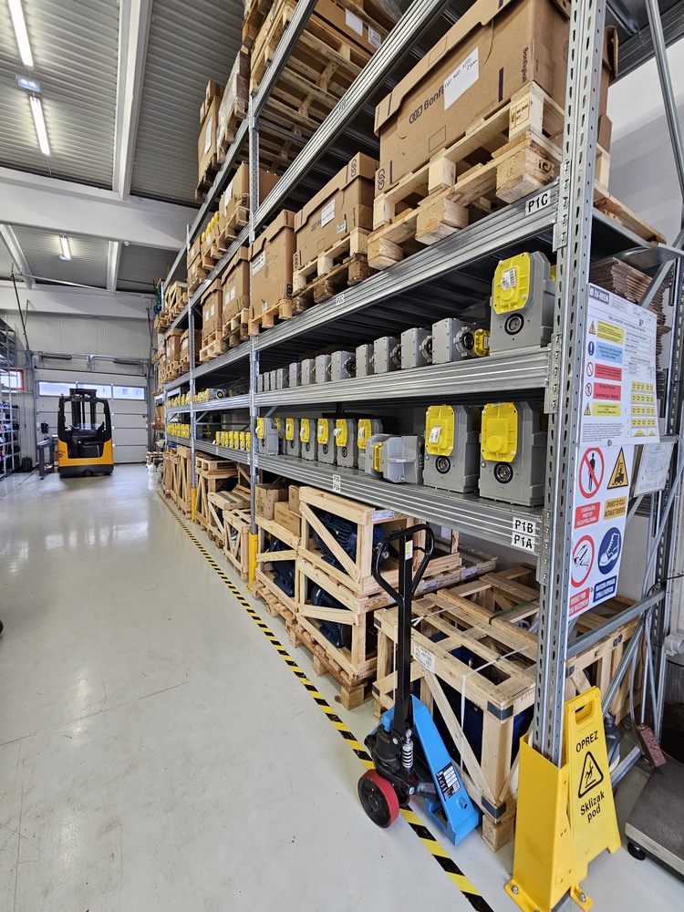
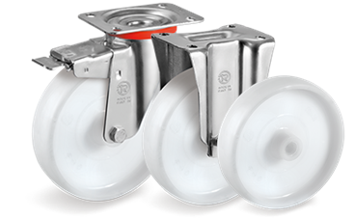
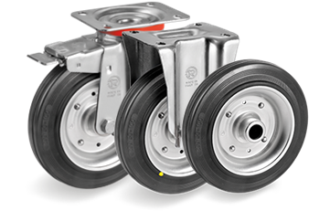

CASTORS
PRODUCT RANGE
✓ Polypropylene
✓ Polyamide
✓ Polyurethane
✓ Rubber wheels
✓ High-temperature wheels
ADVANTAGES
✓ High load capacity
✓ Long service life
✓ Wear resistance
✓ Reliable performance in industrial environments

Slide 13
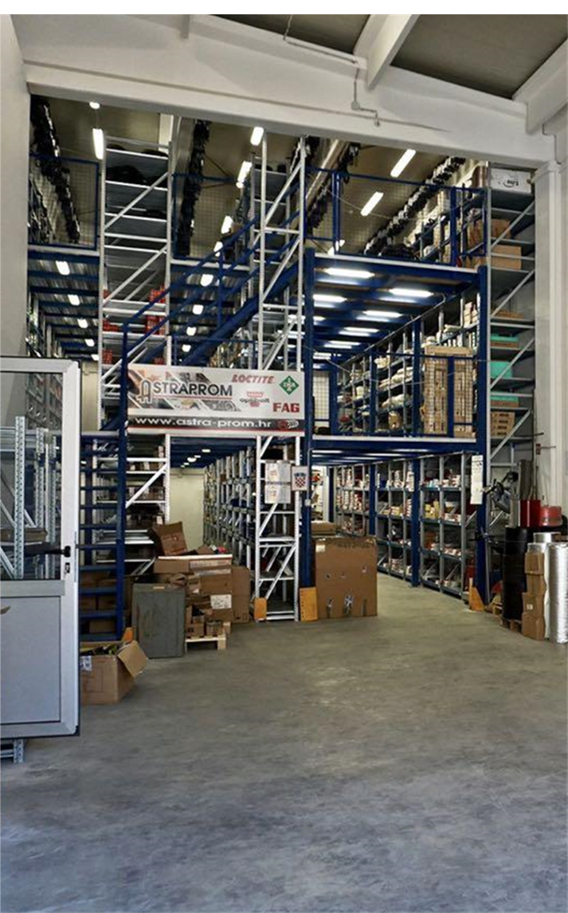




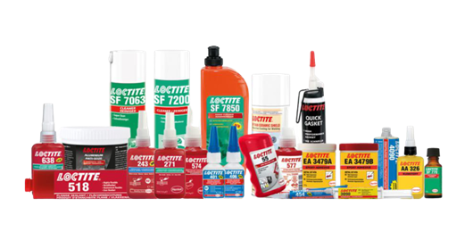
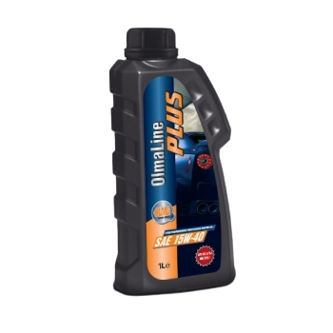
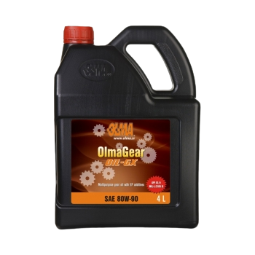
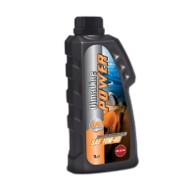
ADHESIVES, OILS AND LUBRICANTS OIL
✓ High efficiency
✓ Protection and lubrication
✓ Resistance to extreme conditions
✓ Professional industrial applications
PRODUCT RANGE
✓ Adhesives and sealants
✓ Industrial lubricants
✓ Technical sprays
✓ Maintenance products

Slide 14
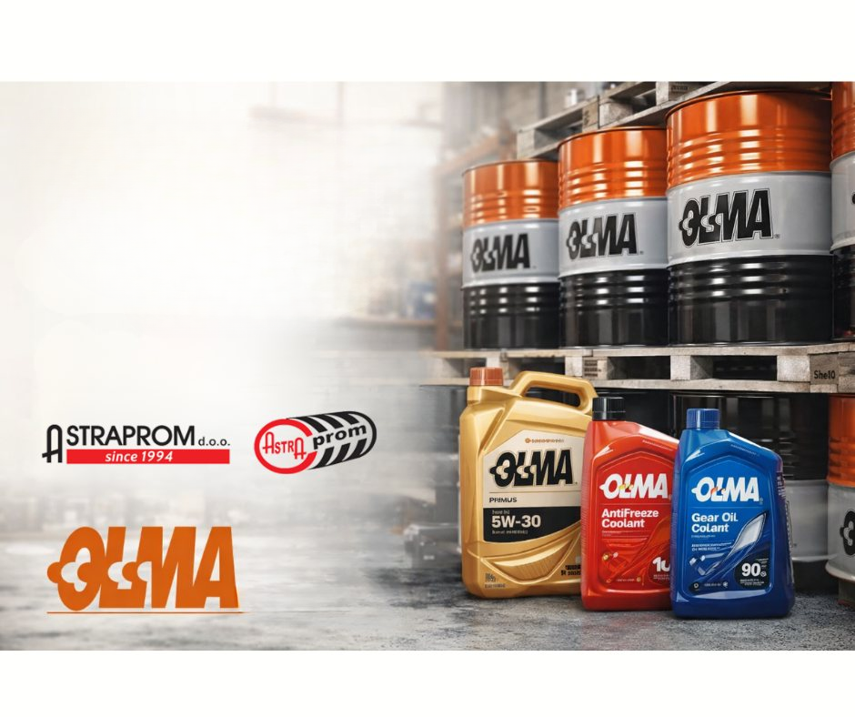
OLMA LUBRICANTS OIL
A wide range of industrial and automotive lubricants
Superior protection and long-lasting machine performance
Reduced wear and increased efficiency
Tailored solutions for various industries

Slide 15

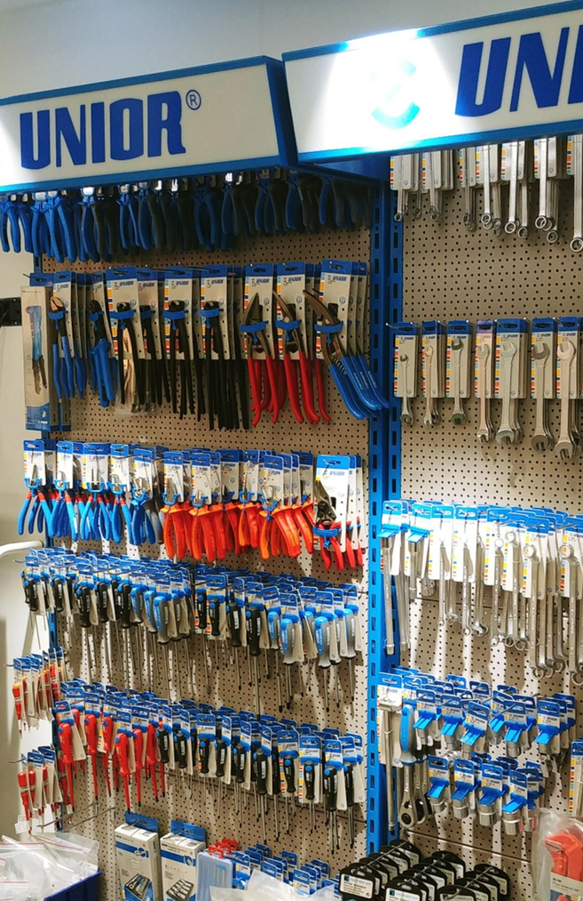
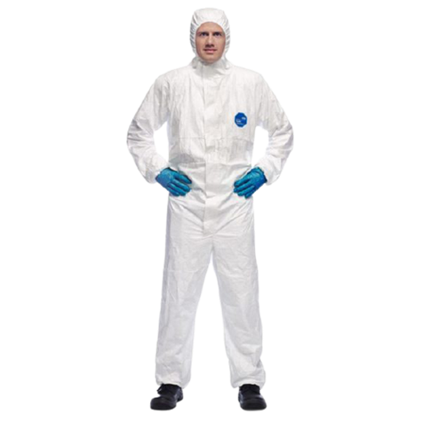
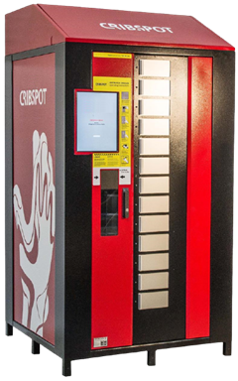
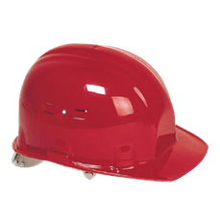
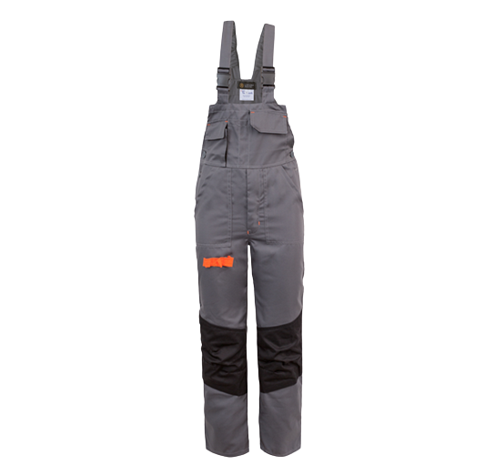
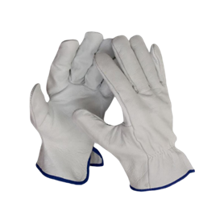
WORKWEAR / SAFETY FOOTWEAR AND VENDING
PROTECTIVE EQUIPMENT
✓ Workwear and safety footwear
✓ Gloves and protective equipment
✓ Helmets and additional gear
✓ Suitable for all industries
VENDING SOLUTIONS
✓ 24/7 product availability
✓ Reduced consumption (30–40%)
✓ Automatic monitoring and control
✓ Maintenance and service included

Slide 16







SEALING PRODUCTS
PRODUCT RANGE
✓ Packing materials
✓ Technical rubber
✓ O-rings
✓ Oil seals
✓ Engineering plastics
APPLICATIONS
✓ Sealing and system protection
✓ Resistance to pressure and temperature
✓ Industrial and technical applications

Slide 17





www.astra-prom.hr
info@astra-prom.hr
Rijeka
Samobor
Novska
Sarajevo
+ 385 51 223 633
Marinići 199
51216 Viškovo
Rudarska draga 11b
10430 Samobor
Zagrebačka ul. 55
44330 Novska
+385912236363

