Slide 1
Efficiency
Payback tool for motors
Online
Software

Slide 2
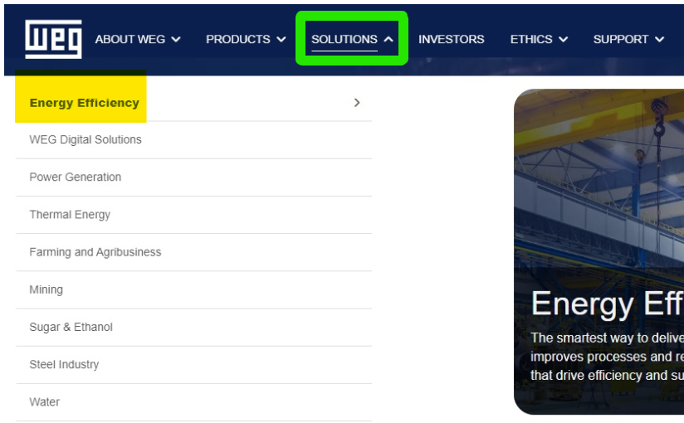
Payback tool
www.weg.net

Slide 3
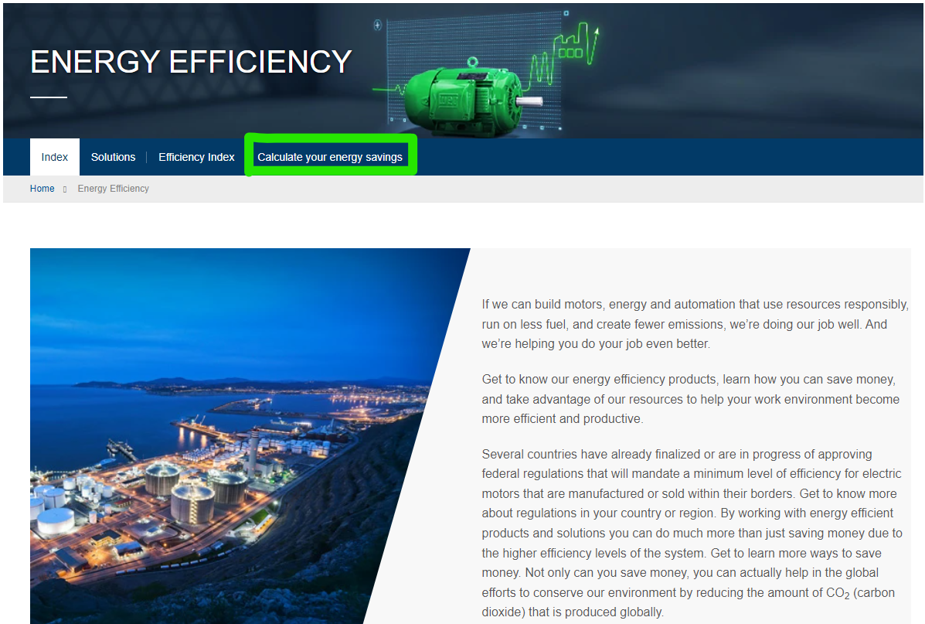
Payback tool
Energy Efficiency | WEG

Slide 4
Payback tool
Energy Efficiency - Calculate your Energy Savings | WEG
- Software
- Online

Slide 5
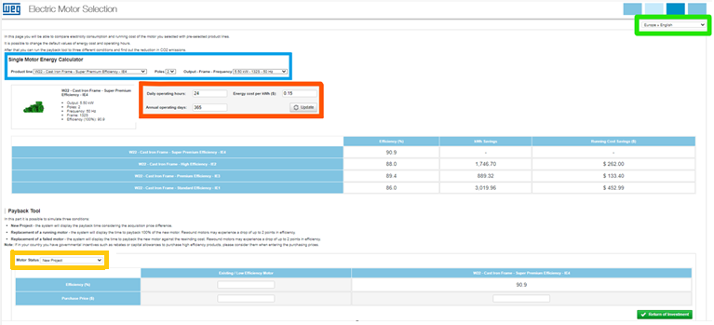
Online Payback tool
WEG -
- Market
- Information needed to calculate
- Motors
- Project

Slide 6
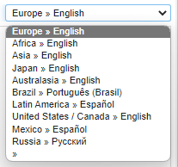
Online Payback tool
Market
Information Needed to calculate

Slide 7
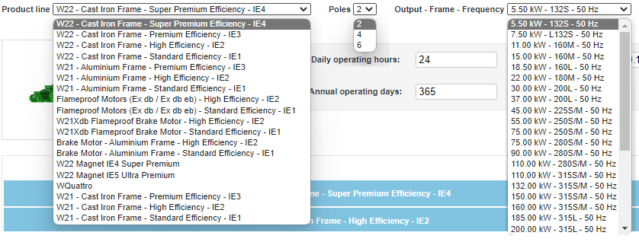
Online Payback tool
Motors
- Information after select the motor

Slide 8
Online Payback tool
Project
- New Project

Slide 9
Online Payback tool
Project
- Replacement of a running motor
- Replacement of a failed motor

Slide 10
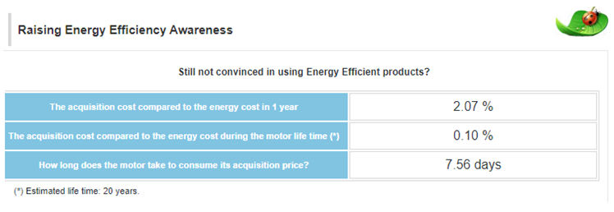
Online Payback tool
Results

Slide 11
WEG Motor Energy Savings Estimator

Slide 12
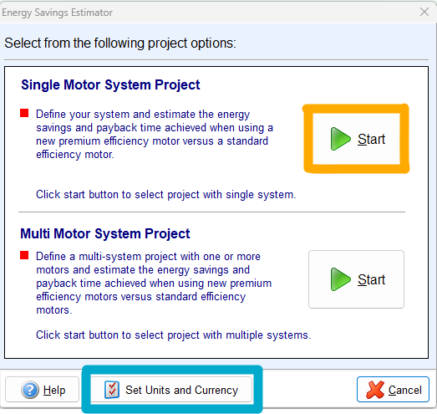
WEG Motor Energy Savings Estimator
New Project

Slide 13
WEG Motor Energy Savings Estimator
Start

Slide 14
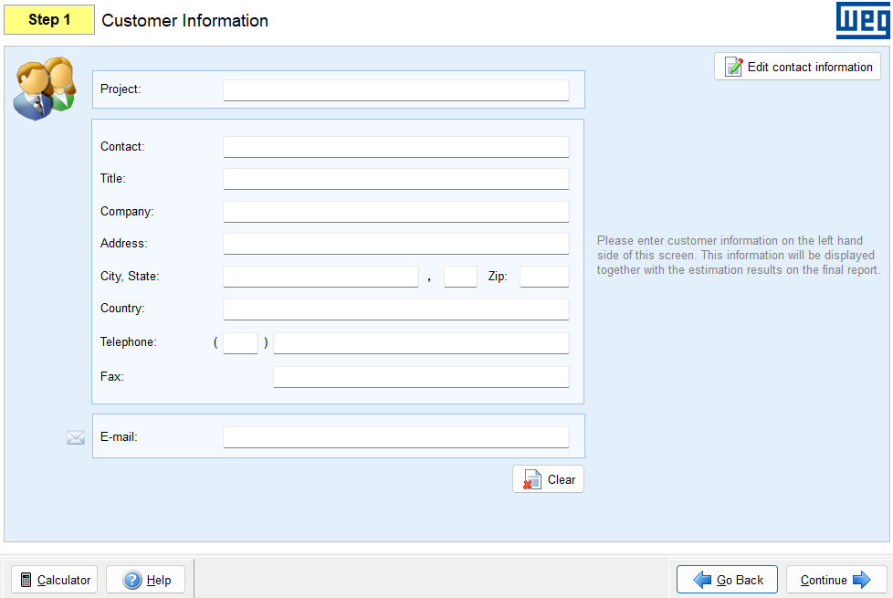
WEG Motor Energy Savings Estimator
1 – Customer Information

Slide 15
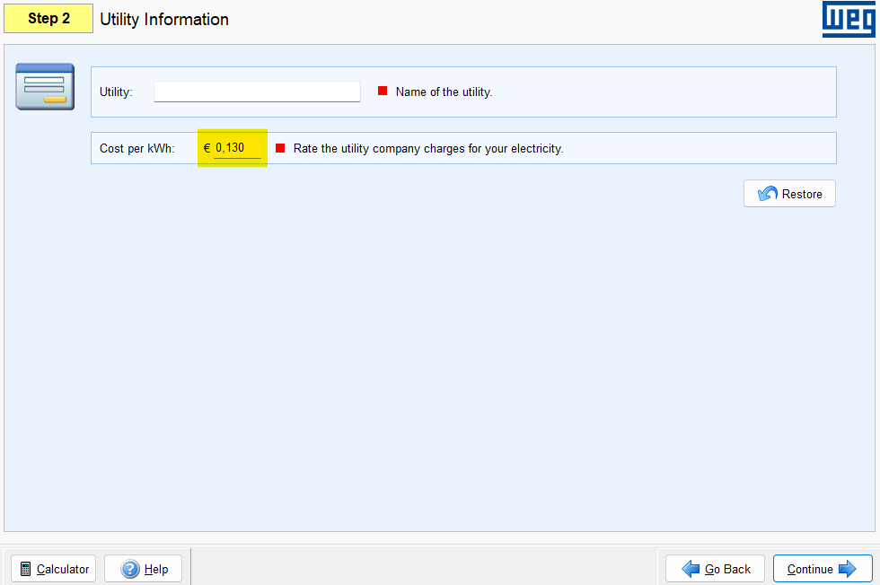
WEG Motor Energy Savings Estimator
2 – Ultility Information

Slide 16
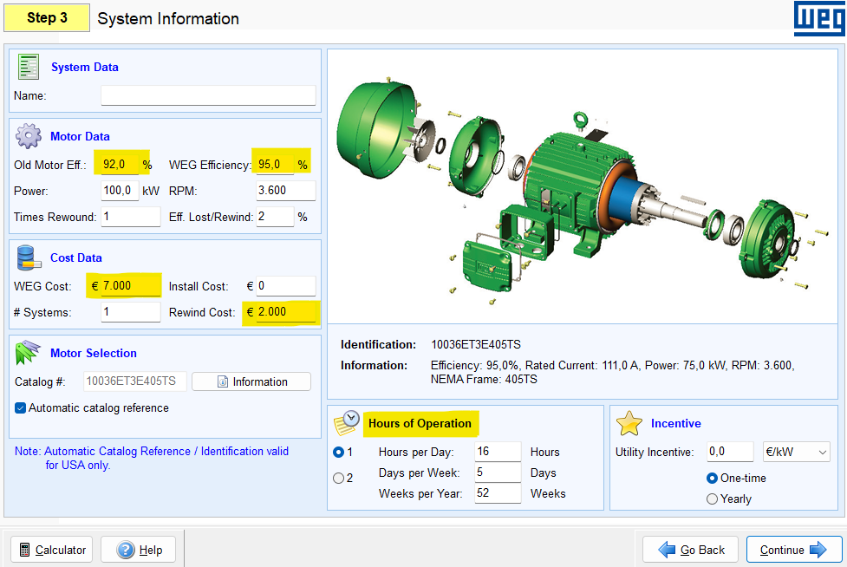
WEG Motor Energy Savings Estimator
3 – Define System

Slide 17
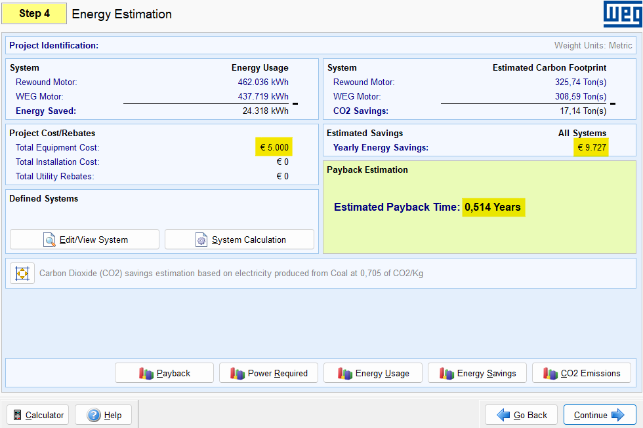
WEG Motor Energy Savings Estimator
4 – Energy Estimation

Slide 18
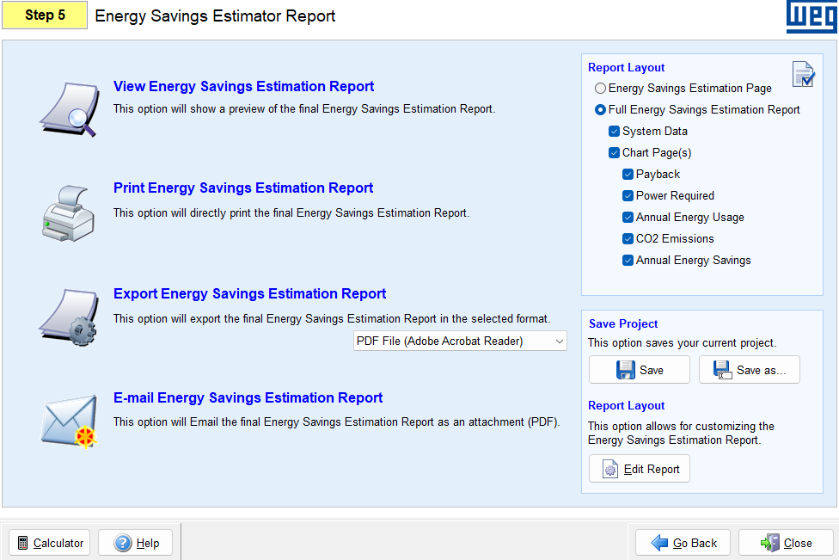
WEG Motor Energy Savings Estimator
5 – View, Print or E-mail Energy Savings Estimation Report

Slide 19
WEG Motor Energy Savings Estimator
Report
WEG Energy Project

Slide 20
Thank You.

