Slide 1
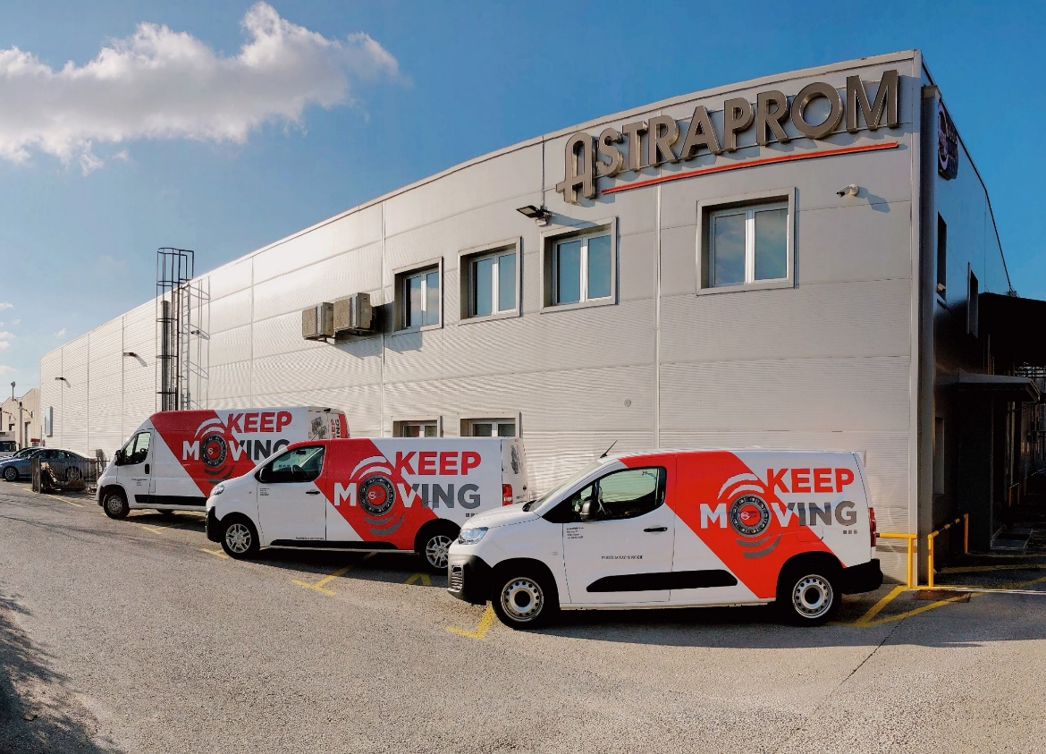
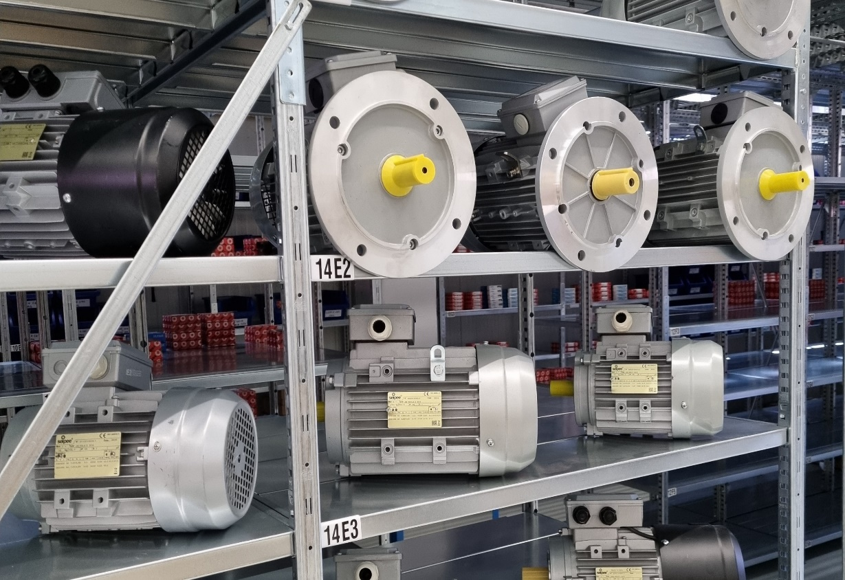
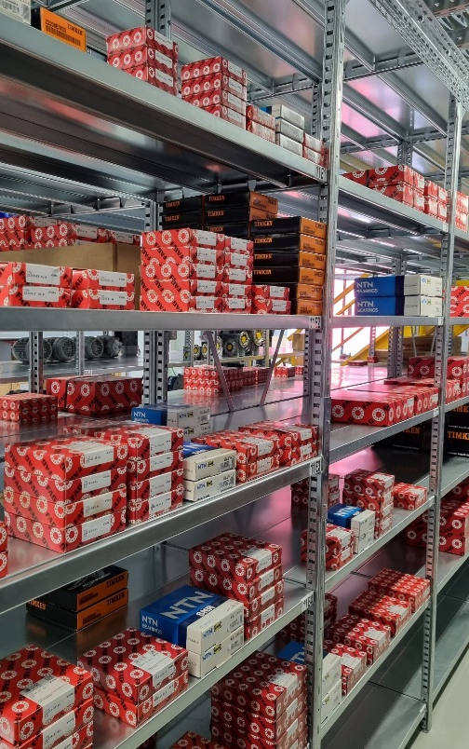
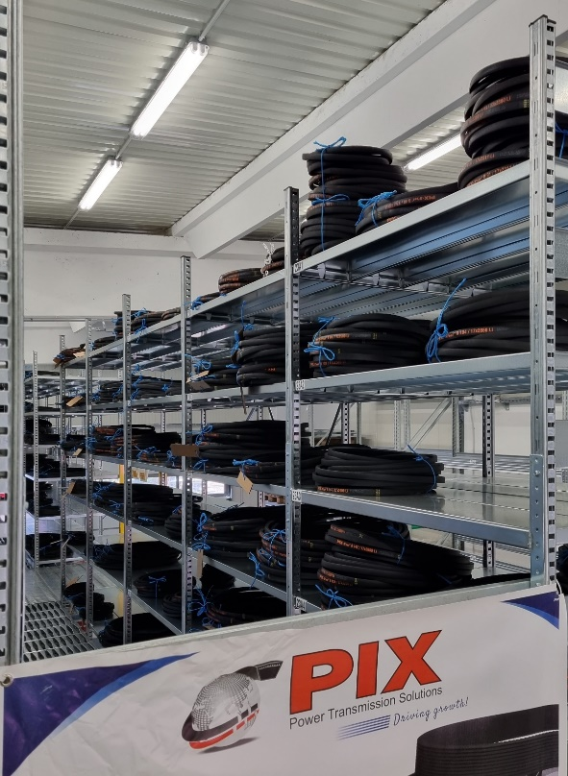
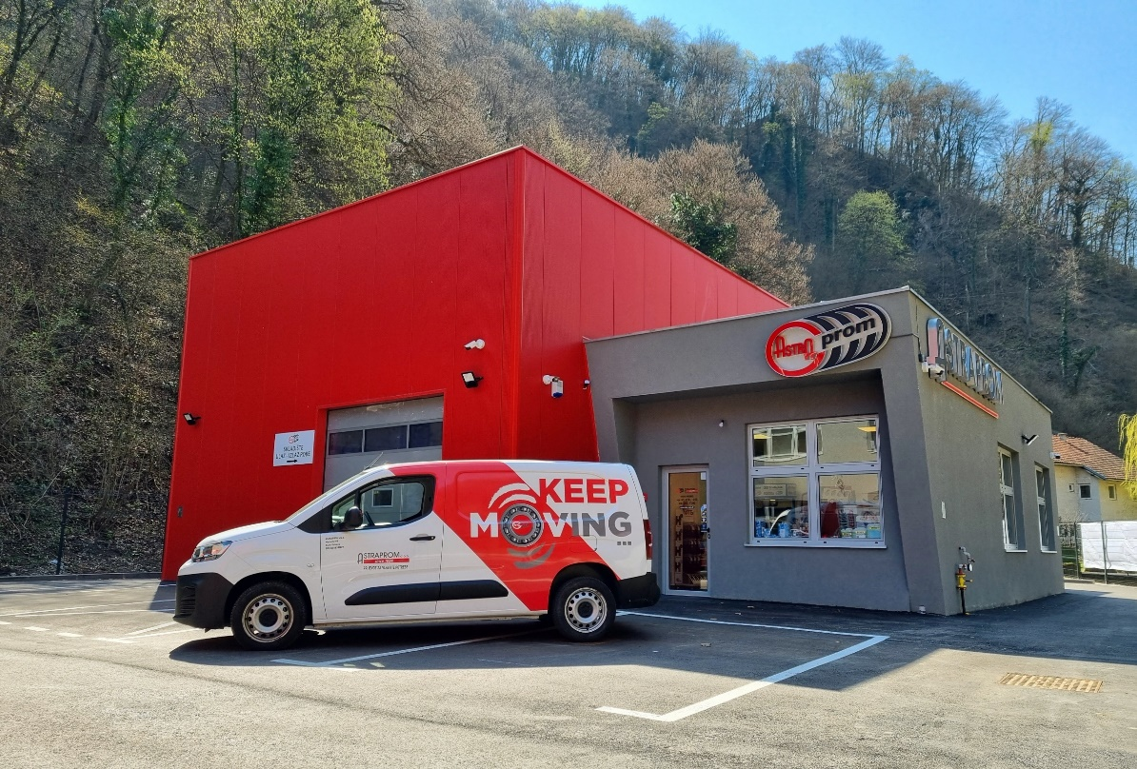
ASTRAPROM D.O.O.
2023

Slide 2
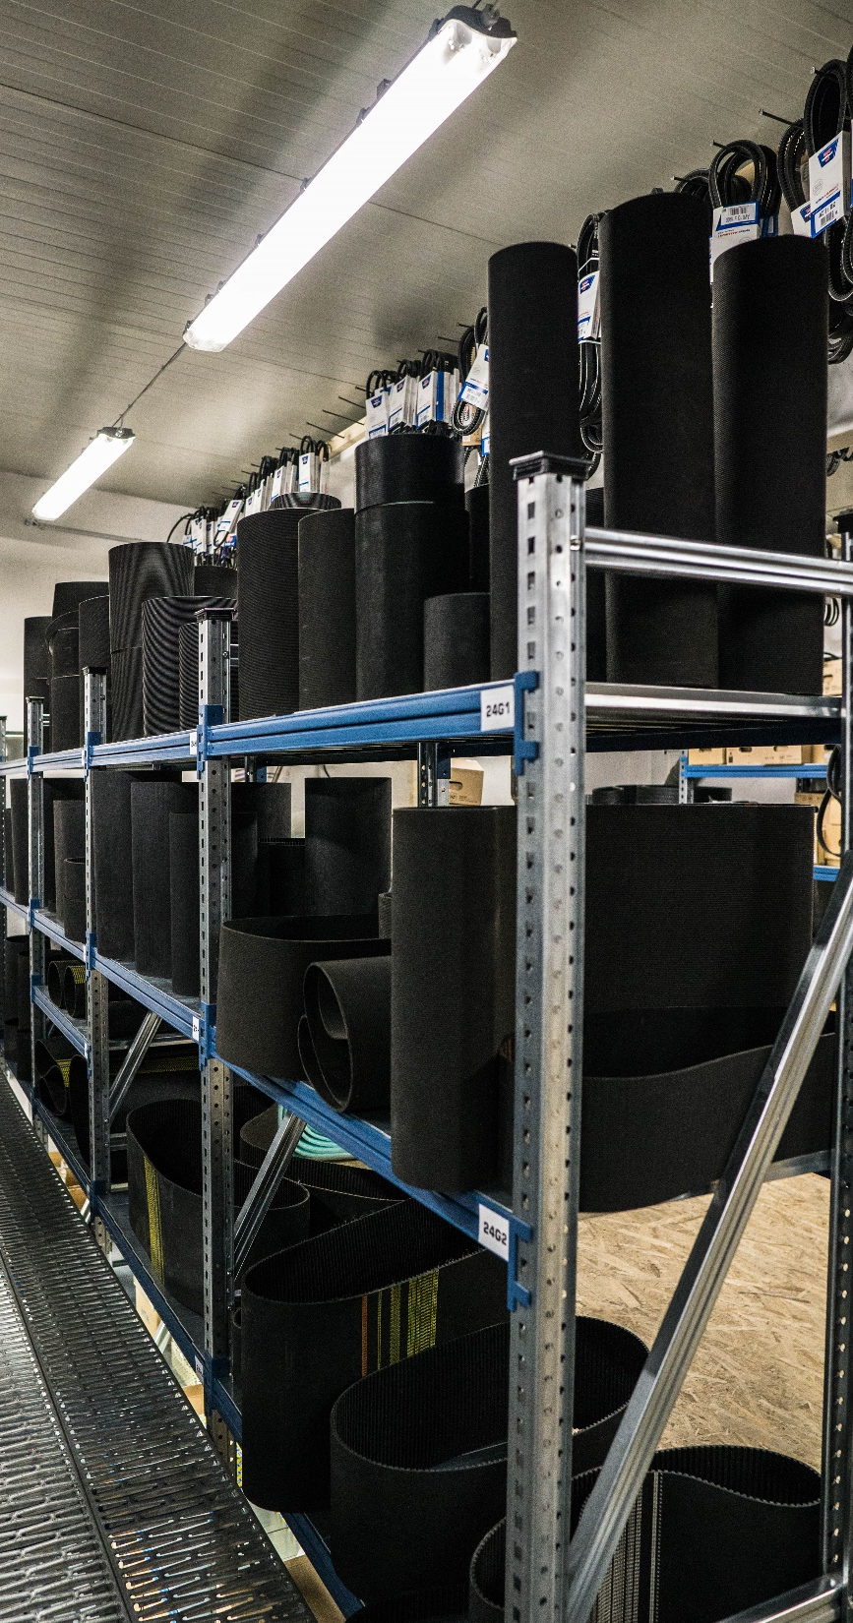
.
OUR MISSION
WHO ARE WE?
Our mission is to maintain a good relationship with our customers and setting high standards in the market. Our products along side with expert employees guarantee competitive prices and high quality service. We respond very swiftly at every enquiry and provide prompt transport of the ordered goods. This all is proof of our high efficiency and professionalism.
Astraprom Ltd. is a familiy bussines founded in the year 1994.
Main company activity is distribution of spare parts for industry, crafts and maintenance.
We offer bearings, electromotors, gearboxes, transmissional belts, transport and drive chains, glues and lubricants, seals and linear technic.
OUR GOAL
Our goal is to remain an internationally renown company recognized as a reliable companion in business. In hope that we succesfully continue cooperation with all our current partners and establish more new ones, we will invest in our resources and knowledge. Satisfaction of our customers always comes first.

Slide 3
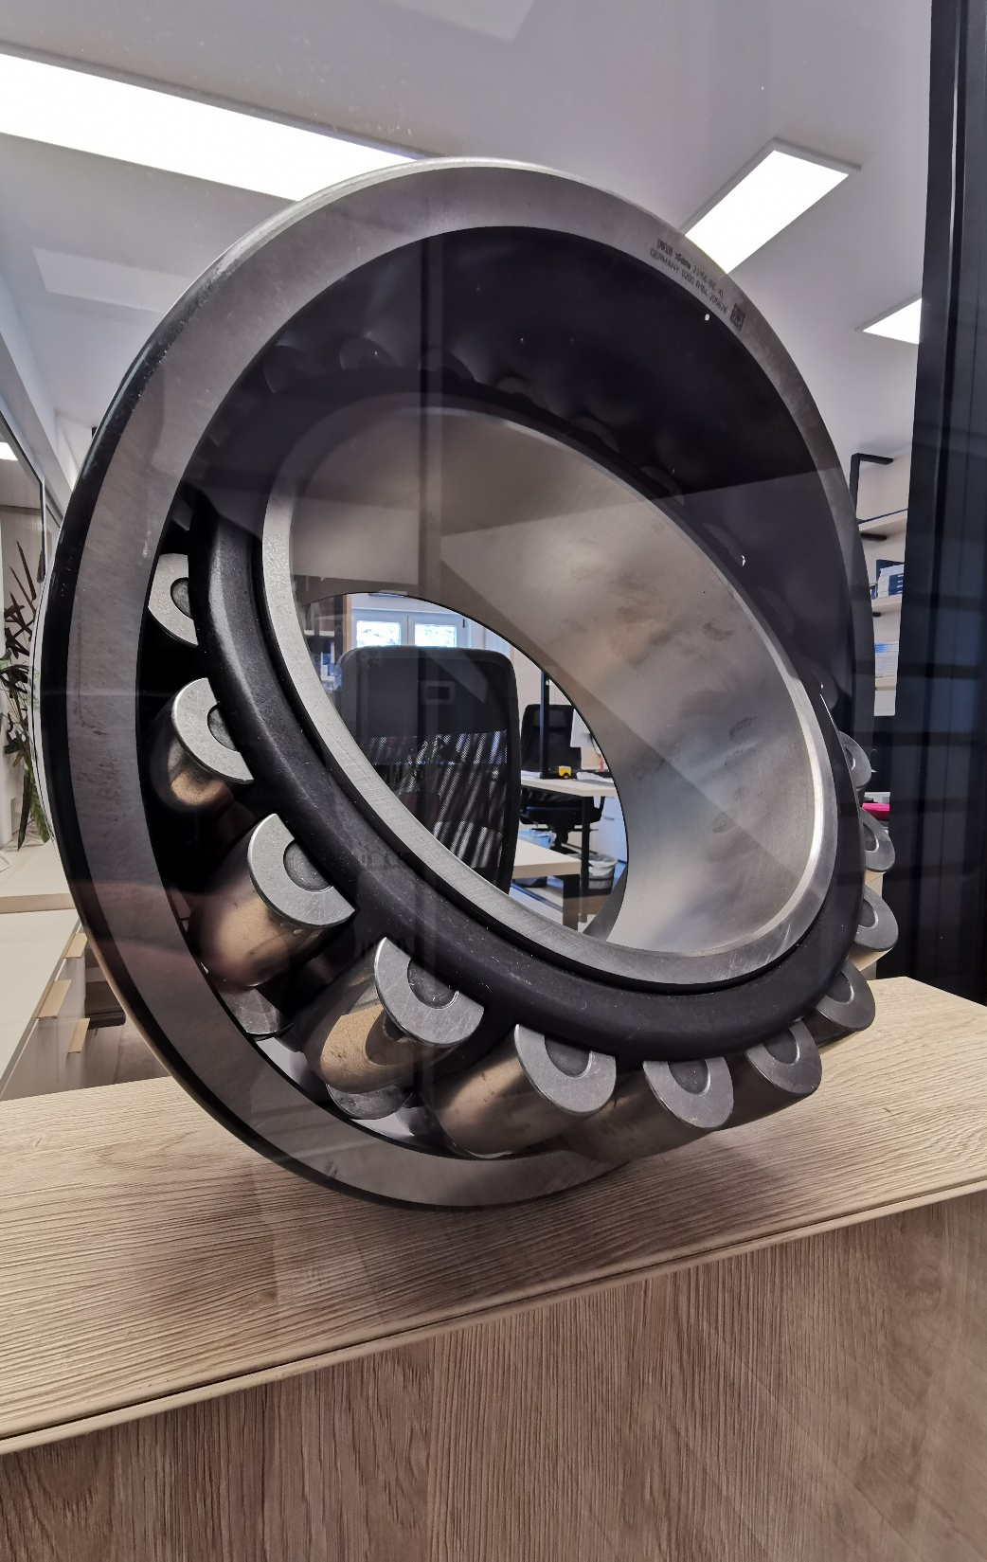
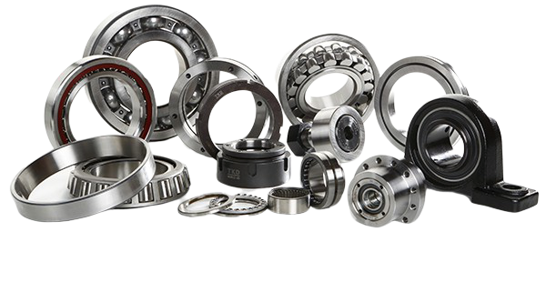
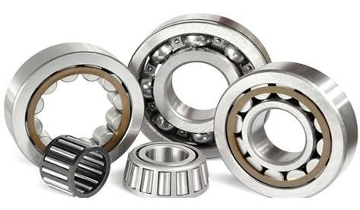
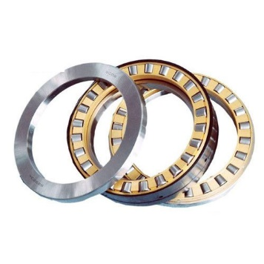
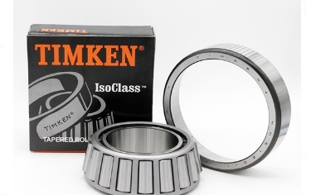
.
Astraprom Ltd. – proud distributor for Schaeffler group (INA i FAG), NTN-SNR, TIMKEN and IKO bearings and housings.
BEARINGS
AND
HOUSINGS
Schaeffler group is the world’s biggest manufacturer of bearings
Quality globally recognized in all industries
NTN-SNR is the 3rd biggest manufacturer of bearings
Industrial bearings for auto, airplane, train industries ecc.
Timken is one of the world's largest manufacturers of bearings and power transmission products and nr. 1 in the US.
Designs, manufactures and sells bearings, gears, automated lubrication systems, belts, chains, clutches and linear motion products.
IKO (Nippon Thompson)
designs and manufactures linear guides, needle and joint bearings that meet the highest quality standards

Slide 4
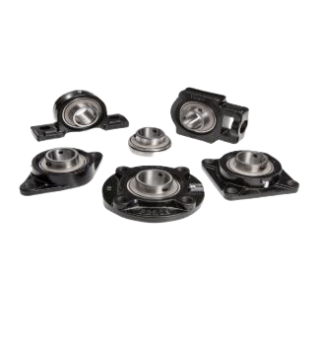
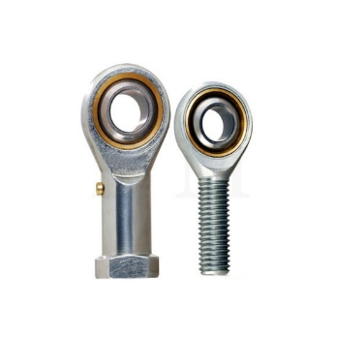
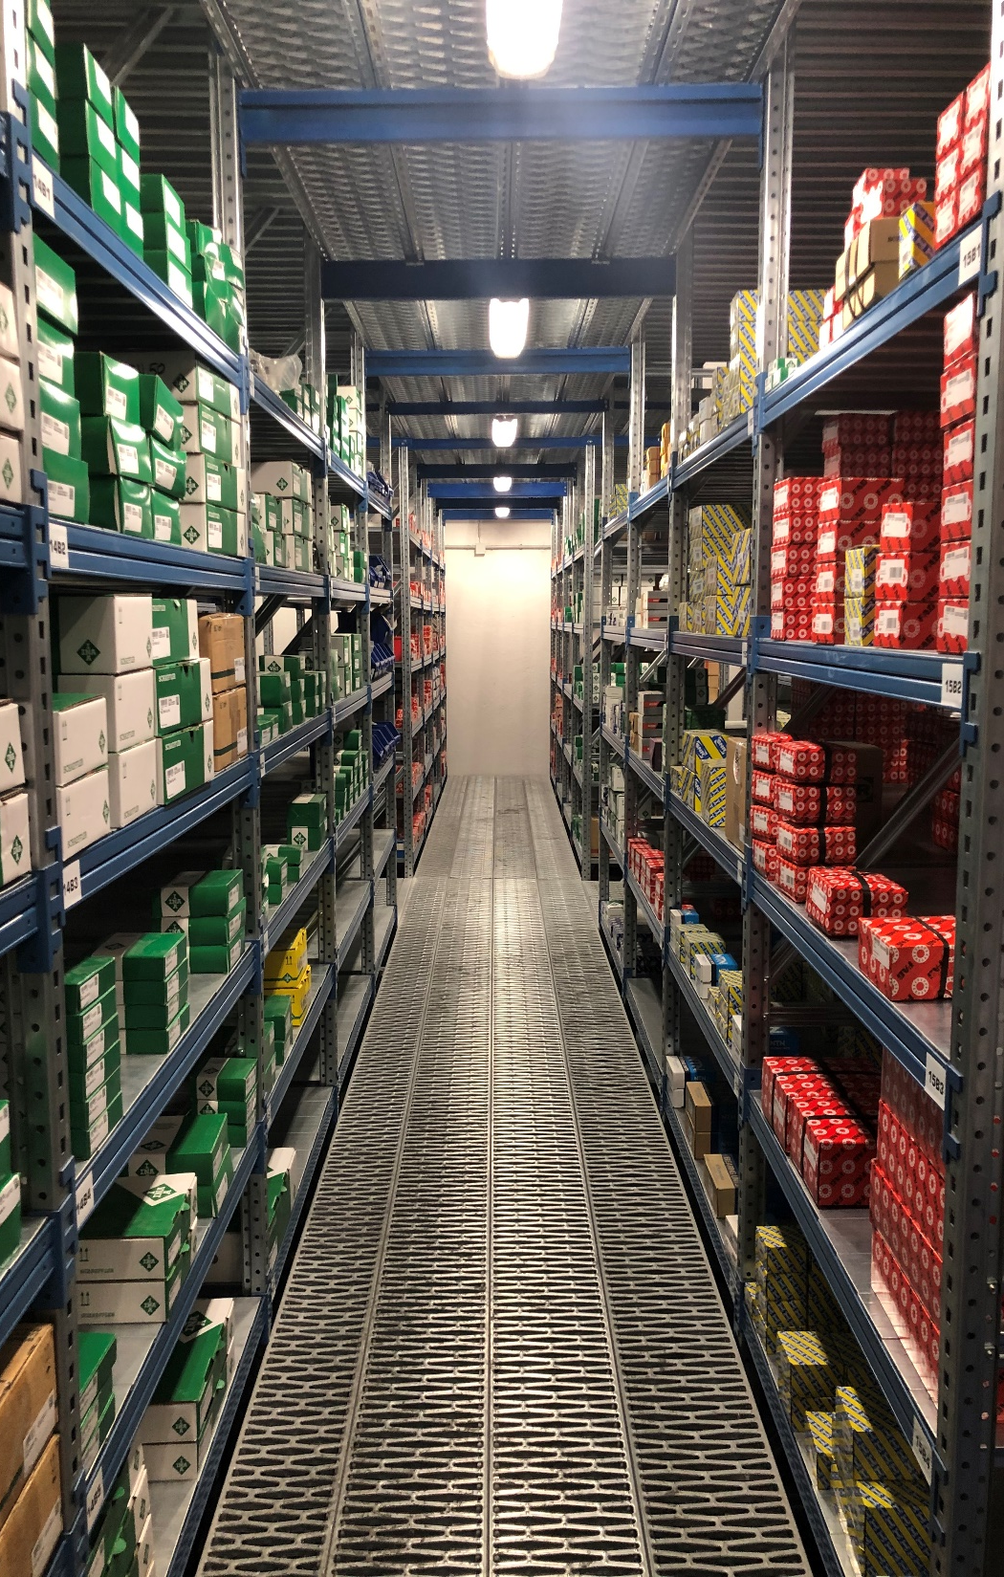
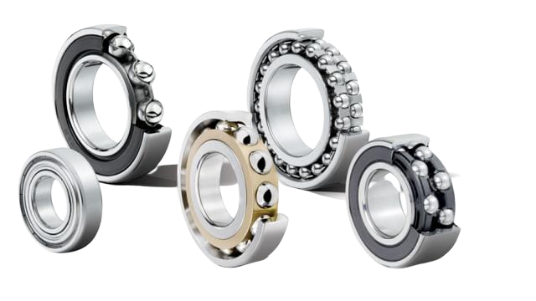
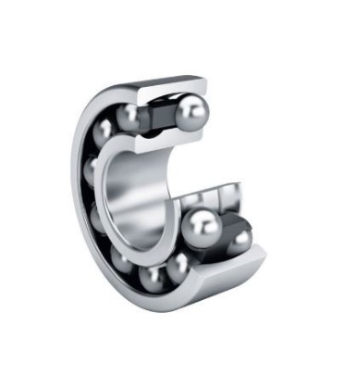
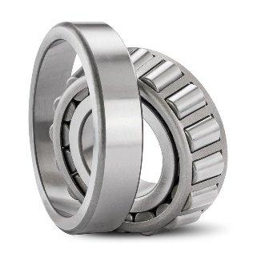
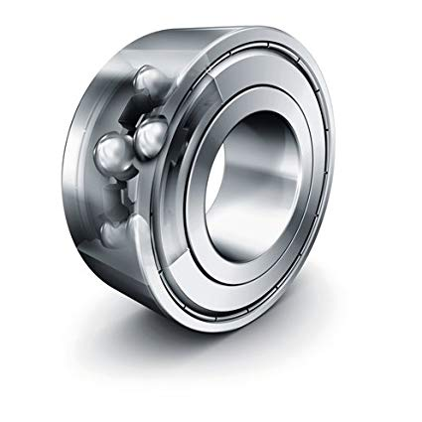
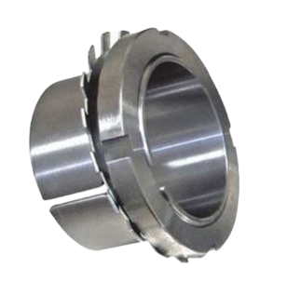
.
BALL
BEARINGS
- Housings with mounted bearings
- Housings for self-adjusting bearings
- Housings without bearings
Rigid ball bearings
Single row deep groove ball bearings
Double row deep groove ball bearings
Spindle bearings
Four-point contact bearings
Self-adjusting ball bearings
Cylindrical roller bearings
Tapered roller bearings
Barrel bearings
Self-adjusting roller bearings
Axial-rigid ball bearings
Axial-cylindrical roller bearings
Axial-self-aligning roller bearings
AND
BEARING
ACCESSORIES
- Needle, articulated and adjustable bearings
- Shells, seals, KM matrices, MB fuses, spacer rings, snaps

Slide 5
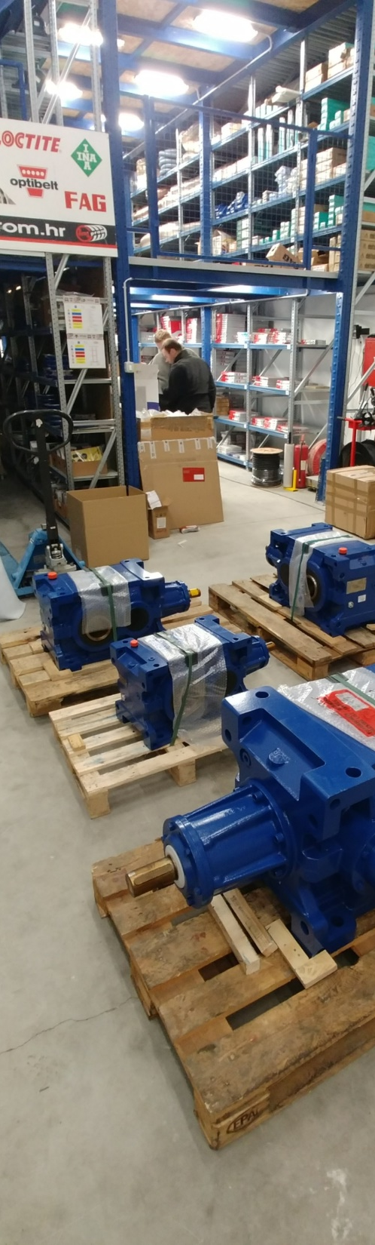
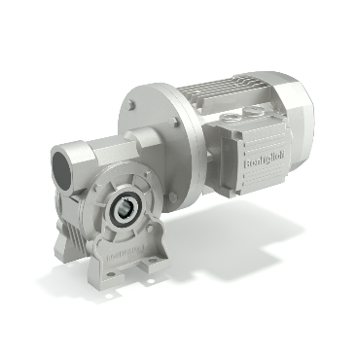
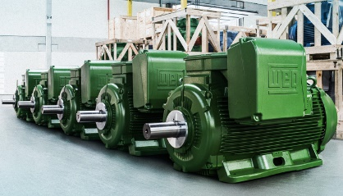
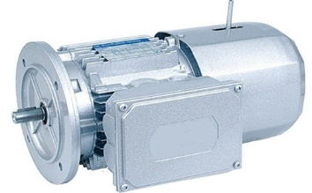
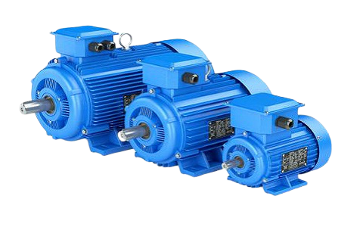
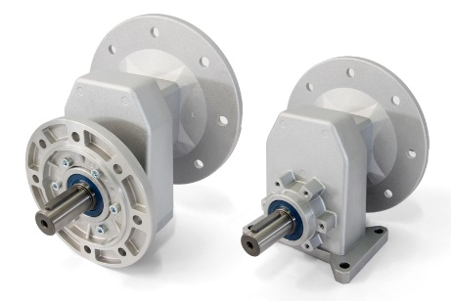
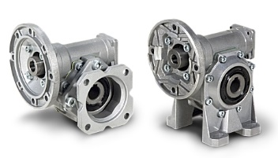
.
- The largest manufacturer of planetary gearboxes for mobile and stationary applications
- World’s leading manufacturer of energy efficient electric motors, automation, power transmission, renewable resource technologies and more
ELECTRIC MOTORS
AND
GEARBOXES
- Specializes in the production of pulleys, gearboxes and other transmission parts
- Designs and manufactures gearboxes, variators and innovative solutions for industry
- Manufacturer of gearboxes, worm gears and right angle gears

Slide 6
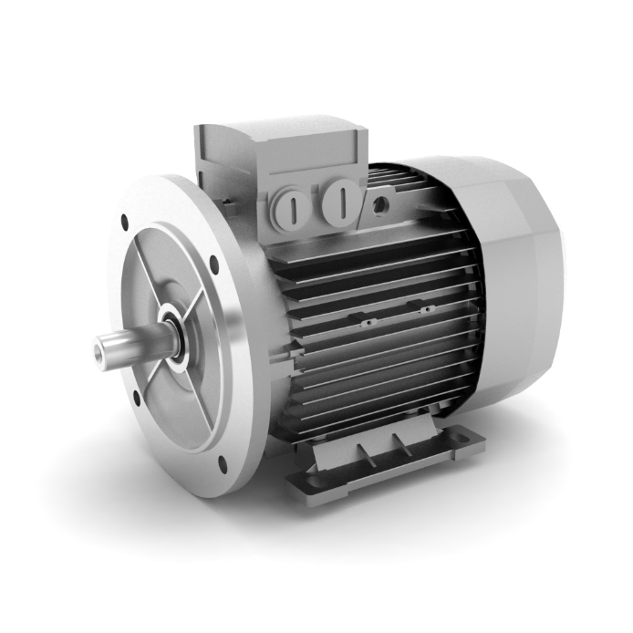
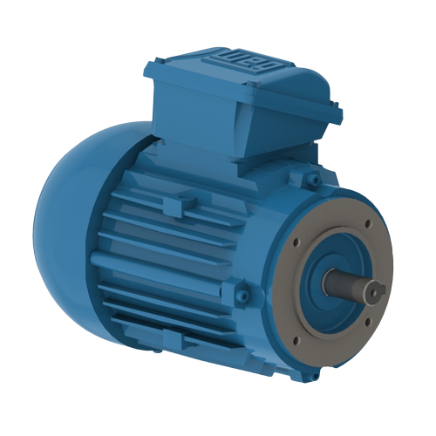
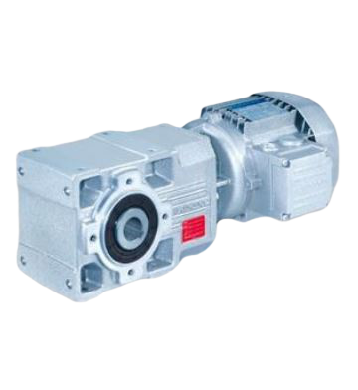
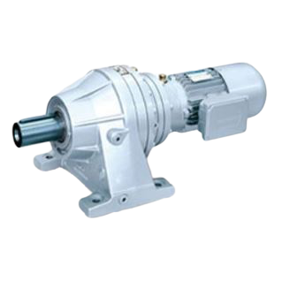
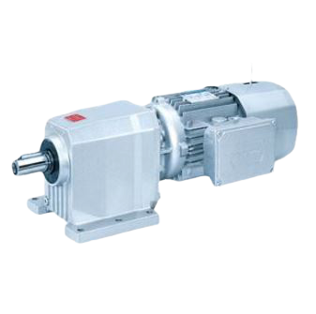
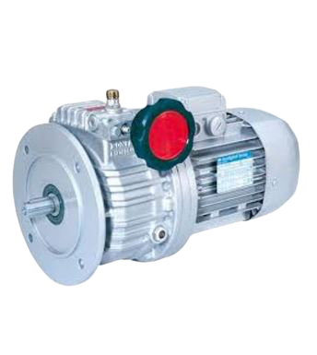
ELECTRIC MOTORS AND GEARBOXES
- From 0.06 - 500 kw
- IE1 IE2 IE3 IE4
- Consumption efficiency
- Single phase (1F)
- Three-phase (3F)
- On legs or with flange (B3, B5, B14)
Worm gearboxes (VF30, VF44, VF49, W63, W75, W86, W110
Gearboxes type A
Gearboxes type C
Gearboxes type F
Stationary and planetary applications
Gearboxes type TA
Mechanical variators
Frequency converters
Planetary gearboxes for stationary and mobile applications
I
PRIBOR ZA LEŽAJEVE

Slide 7
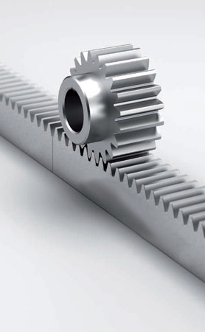
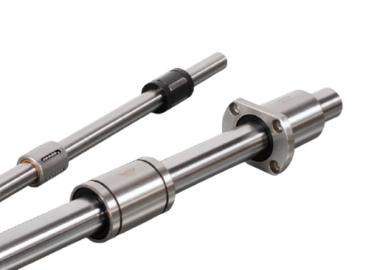
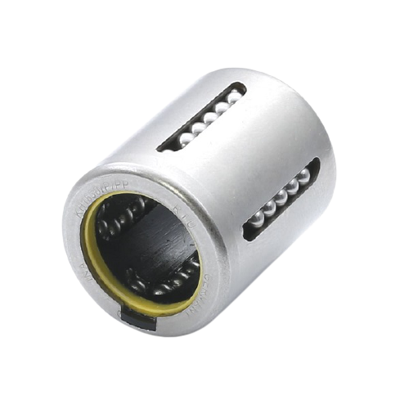
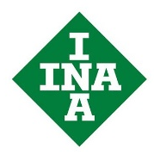
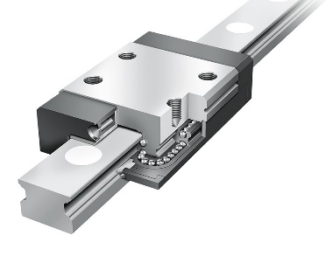
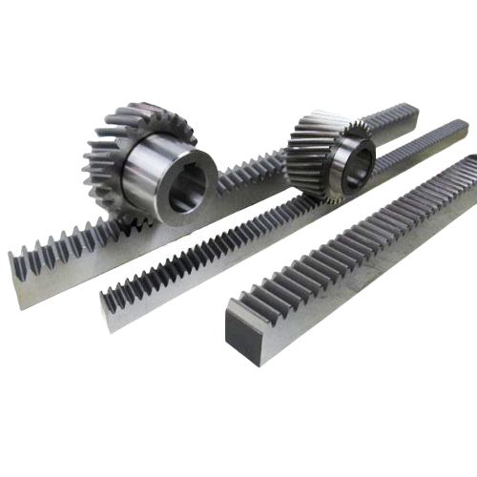
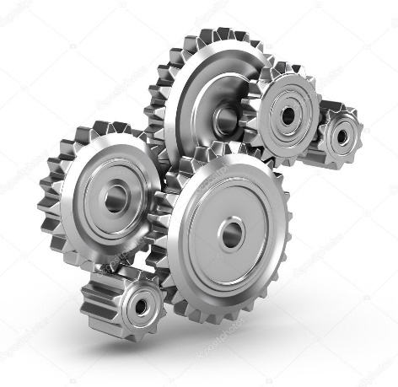
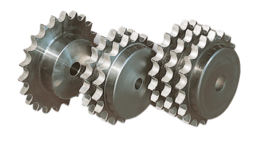
.
LINEAR GUIDES (RAILS), BLOCKS AND LINEAR BEARINGS
LINEAR TECH
- In our offer you can find a large selection of gears with or without hub, different diameters, number of teeth and material
- We are able to make non-standard toothed racks and gears adapted to special conditions and requirements
SPUR GEARS
AND SPUR GEAR
RACKS

Slide 8
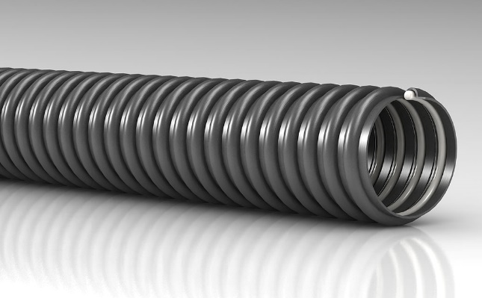
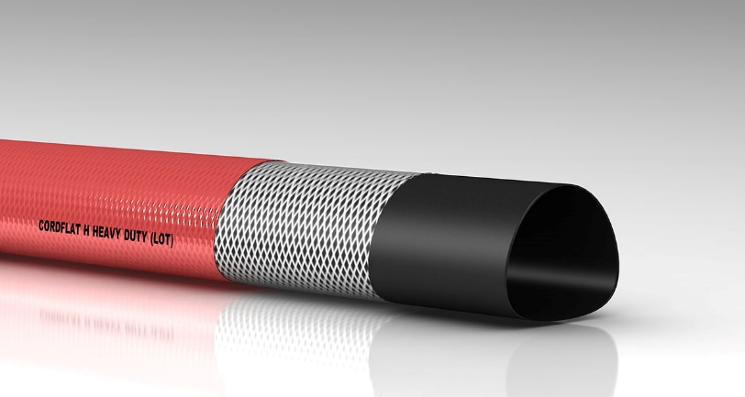
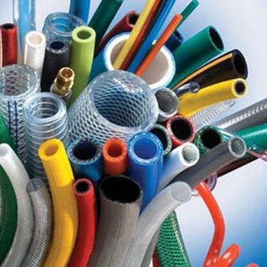
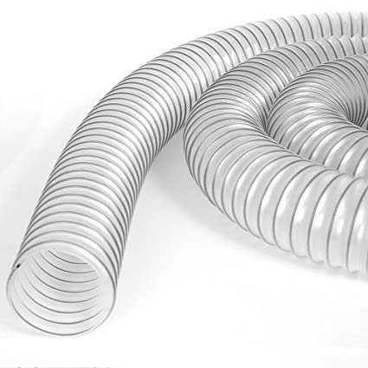
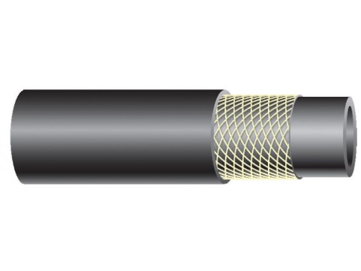
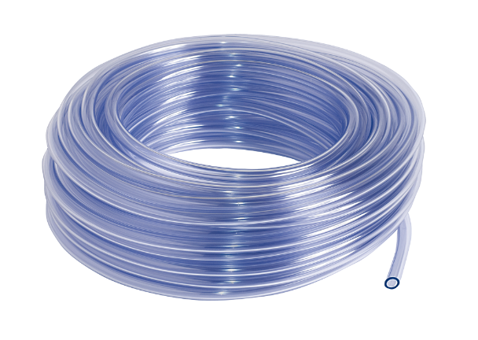
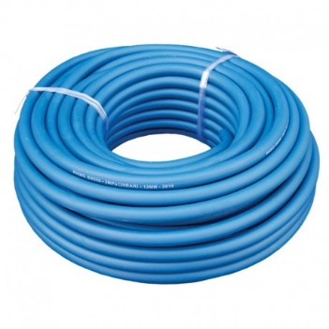
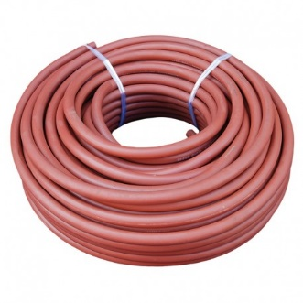
.
- We offer a complete range of rubber and PVC hoses that are used to transport various media such as water, air, oil, gases, food products and chemicals
HOSES

Slide 9
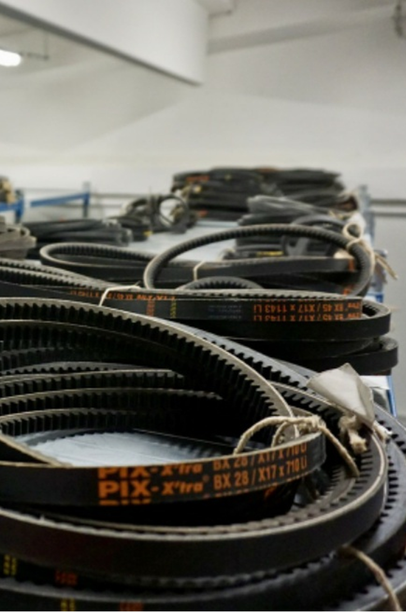
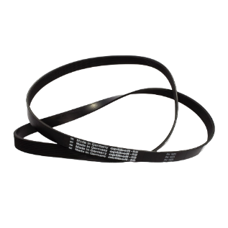
We offer belts made of top materials that provide optimal resistance to bending, the possibility of using pulleys with smaller diameters, high gears, high coefficient of friction, reduced slip, resistance to high temperatures, oils, greases, chemicals, ozone, all of which allows energy saving and longer belt life.
We are proud distributors for Pix, Optibelt i Megadyne.
BELTS
AND
PULLEYS
V BELTS
TIMING BELTS
- 5, 6, 8, 10, 13, 17, 20, 22, 25, 32 i 40 mm
- T2.5, T5, T10, T20
- SPZ (9,7mm), SPA (12,7mm), SPB (16,3mm), SPC (22mm)
- AT5, AT10, AT20
- 2M, 3M, 5M, 8M, 14M
- AVX10, AVX13, AVX17
- L, XL, H
- XPZ (9,7mm), XPA (12,7mm), XPB (16,3mm), XPC (22mm)
GEAR PULLEYS

Slide 10
.
We are proud representatives of the world’s leader in the production of Renold chains
- Sprockets are elements of machines that form a chain drive alongside the chain
CHAINS
AND
CHAIN SPROCKETS
Our offer includes:
Gal chains
Transport chains
Lifting chains
Sprockets
Chain guides
single-row, double-row, three-row
With hardened gearing, pilot hole with conical bushing
RENOLD SD, RENOLD SYNERGY, RENOLD SYNO, RENOLD A&S, SOVEREING, STAINLESS STEEL, HYDRO SERVICE, ROLL-RING, RENOLD BLUEBOX

Slide 11
.
- Couplings are elements of machines that are used for permanent or occasional connection of two shafts for the purpose of torque transmission, compensation of minor deviations of the shaft axis and reduction of torsional vibrations
COUPLINGS
AND
COUPLING
ELEMENTS
- A leader in the development and production of innovative power transmission components for industrial plant applications
- Offers various types of couplings that are of excellent quality, reliable construction and with an easy way of maintenance
- Designs and produces drive solutions and provide complete solutions for just about every industry.
- ESCO is a family owned business specialized in designing, manufacturing, selling and distributing power transmission products and services.

Slide 12
.
We offer:
Polypropilene
Polyamide
Polyurethane
Wheels for high temperatures
Rubber wheels
Tellure Rôta is a manufacturer of industrial wheels and guarantees high-quality products made in Italy for the production of which it uses the latest technologies on the market.
INDUSTRIAL
WHEELS

Slide 13
.
GLUES,
OILS
AND
GREASES
- We offer all lubrication devices and technical support for all tools
- Highly efficient solutions for gluing, sealing and coating surfaces
CRC Industries Europe is a worldwide supplier of chemical products for the industry, automotive and electro segments.
UNIVERSAL
HEAVY DUTY
VIB
HIGH TEMP
ULTRA HIGH TEMP
FOOD AL
HIGH SPEED

Slide 14
.
We offer work clothes and footwear adapted to all types of industry
The workwear materials we offer provide properties such as breathability, waterproofness, stretchability on individual parts and robustness as needed.
PROTECTIVE
WORK GEAR
AND
VENDING
The use of vending machines ensures access to products 24 hours a day, reduction of consumption of safety equipment at work by 30-40%, filling of items and maintenance led by the contracted partner, 490 compartments inside the device.
- 24h access to
products
- assistance
available 24/7
- maintenance
- changes of products on demand
- access to reports
and analytical system
- education on request

Slide 15
SEALING
PRODUCTS
SEAL GASKETS
TECHNICAL TIRES
SEALING PLATES
RUBBERIZED CORK
GLASS CLOTH
OIL SEALS
„O” RINGS
TECHNICAL PLASTICS
TECHNICAL FELT

Slide 16
SELLING AND LENDING OF
TOOLS
- For sale and rent we offer inductive heaters, hydraulic extractors, high pressure pumps, hand and power tools and other tools for assembly, disassembly and monitoring of bearings and condition monitoring
TECHNICAL ADVISING
We help with:
- Assembly and disassembly of bearings
- Shaft calculation
Choosing a linear technique
Choosing lubricants

Slide 17
Astraprom Ltd.
RIJEKA
Administration and Business Unit: Marinići 199, 51216 Viškovo, Croatia
ZAGREB
Business Unit, Warehouse, Wholesale, Retail: Rudarska draga 11b, 10430 Samobor, Croatia
www.astra-prom.hr
E-mail: info@astra-prom.hr
Office:
Tel: + 385 51 223 633
Retail:
Tel: + 385 51 624 192

